Slide 1

EOS
The UNPERMISSIONED blockchain that solves the black swan
Presented by

Slide 2
Disclaimer
We are NOT in any way associated with block.one, the company developing EOS code. We are just part of the emerging EOS community.
We have no interest in you buying EOS tokens, and this certainly should not be treated as financial advice.
Our goal is to encourage you to take interest in the concept and possibly consider building businesses on top of EOS.

Slide 3

CREDITS
Ian Grigg has been in the financial cryptography space since 1995, when he ran a startup to issue and trade bonds digitised as contracts. Since then he has worked on digitising cash, precious metals, identity, social savings, and bringing DLT to financial institutions. He is now working on a number of blockchain and DLT related projects including EOS.

Slide 4
TRADING = DEALING WITH COMPLEXITY
Blockchain is about trading, i.e. moving assets around
We like complexity - this is the very reason we trade
Complexity means risk: lots of things can go wrong, especially on a blockchain

Slide 5
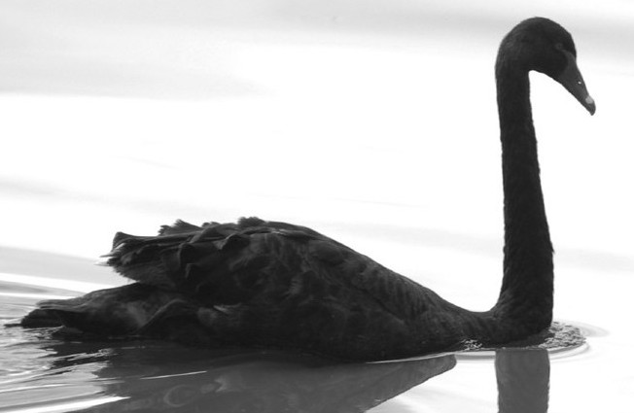
BLACK SWAN
An event that happens very infrequently but it’s extremely costly

Slide 6
WHAT DOES THE BUSINESS NEED?
Repeated, no-end-in-sight game
Way out when things go wrong - rules to manage a black swan event
Ideally win-win / net-positive game open to everyone

Slide 7
TWO ALTERNATIVE FORMS OF BLOCKCHAIN
Unpermissioned Blockchain
Permissioned Blockchain

Slide 8
UNPERMISSIONED blockchains
Bitcoin & Ethereum
Everyone is free to enter
Designed to do simple automation only: simple contractual mechanisms
Emphasis on smart-contracts & external oracles to feed information in
When it comes to the actual business: Wild West („code is the law”)

Slide 9
PERMISSIONED blockchains
Ripple & Hyperledger
Ideally suited for banks & large institutions
Paradigm of a walled garden: you can get in only if you're permitted in
Rules to suit the insiders, small businesses get locked out
It’s quite safe - you’re unlikely to misbehave because you risk being kicked out

Slide 10
Dilemma SAFETY vs. FREEDOM
The unpermissioned blockchain:
Good: freedom of entry
Bad: the entrepreneur is looking for win-win, but gets win-lose
The permissioned blockchain
Good: entities inside can safely trade, encourages win-win game
Bad: you can't have a vibrant growing economy in a walled garden

Slide 11
Unpermissioned VS. Permissioned BLOCKCHAIN
 | Good | Bad
Unpermissioned | Freedom of entry prevents corruption & boosts market competition | The entrepreneur is looking for win-win, but mosty gets win-lose game
Permissioned | Entities inside can safely trade, win-win game is encourged | You can't have a vibrant growing economy in a walled garden

Slide 12
THE PROBLEM WITH black SWAN
In real-life there are safety mechanisms, i.e. legal infrastructure
On a blockchain: no safety net, e.g. the DAO incident
Unpermissioned blockchain encourages win-lose / zero-sum game:
if you want to get ahead in a trade, let's do a DDoS
if you want to get ahead with a contract, let’s hack the contract

Slide 13
The entrepreneur wants a free-to-enter system where they can deal with people and build profits, not extract profits.
Ian Grigg, block.one partner

Slide 14
The blockchain for business is the blockchain that solves the black swan.
Ian Grigg, block.one partner

Slide 15
WHAT We need IS a governed blockchain

Slide 16
HOW DO WE BUILD a GOVERNED BLOCKCHAIN?
Set of rules: the Constitution
The community is the people who have agreed to the constitution
Governance infrastructure:
referenda to appoint the rules
arbitration to resolve disputes around the rules
execution to implement to rules

Slide 17
EOS is that third choice, the governed blockchain. In essence what we have is the safety on par with the permissioned blockchain, and the freedom of entry of the unpermissioned blockchain
Ian Grigg, block.one partner

Slide 18
HOW DO WE BUILD a GOVERNED BLOCKCHAIN?
Community
Constitution
Computer Code

Slide 19


HOW DO WE BUILD a GOVERNED BLOCKCHAIN?
Constitution
Referenda
Arbitration
Execution
System of values
Computer code

Slide 20
DPOS - DELEGATED PROOF OF STAKE
21 block producers elected by token holders
Hard to get elected, easy to lose the job
Executors of the constitution, e.g.
apply protocol changes
ability to freeze & fix broken dApps
Subjects to the constitution: risk being voted out if violate the constitution

Slide 21
WHY DO WE NEED A CONSTITUTION?
The constitution is the expression of common values within a community
No constitution = no common values explicitly defined
Eventually something controversial will happen
A constitution exists to minimize the likelihood of a fork, which is a bad thing

Slide 22
EOS - THE Governed BLOCKCHAIN
 | Black Swan prevention | Stagnation prevention
Unpermissioned | - | Free to enter
Permissioned | Walled garden | -
Governed | Constitution | Free to enter

Slide 23
The fallacy is that we need a wall. Actually, we don't need a wall. What we need is controls.
Ian Grigg, block.one partner

Slide 24
WHAT We ALSO need IS GOOD USER experience

Slide 25
EOS is the blockchain for building commercial scale decentralized applications that are indistinguishable from centralized alternatives.
Daniel Larimer, CTO of block.one

Slide 26
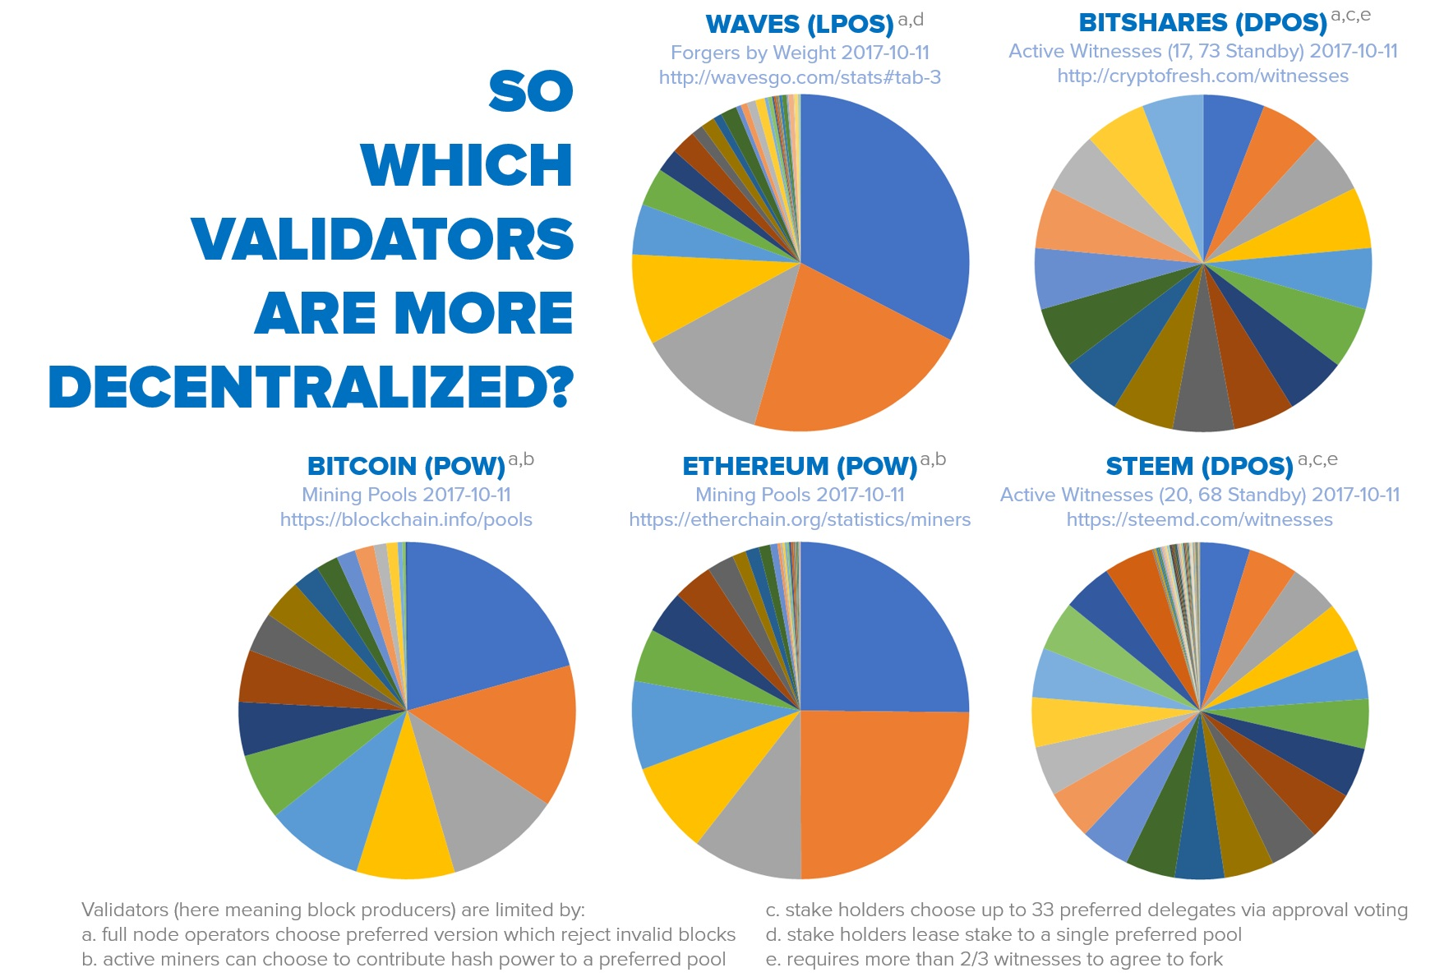
Delegated proof of stake (DPOS) HOW decentralized IS IT?
Source: senzheng on reddit.com

Slide 27
IS FULLY autonomous SYSTEM Possible?
Vitalik Buterin: If we could only put the right algorithm inside a box, then it could be fully self-suffcient or autonomous
Daniel Larimer: There is no such thing as an autonomous economic system, it’s always dependent on a value system outside of it

Slide 28
Kurt Gödel’S incompleteness theorem
Any logical system can be either complete or consistent, never both.
There are always axioms which are outside of a system.

Slide 29
DAN Larimer’s Darwinian approach
Each community might have its own hierarchy of values (i.e. value system)
A good value system will allow a group to grow
A bad value system will eventually make it die

Slide 30
The true goal is to lower the barrier to entry for the creation of new communities and allow free market competition to reward the most effective communities and punish the most corrupt.
Daniel Larimer, CTO of block.one

Slide 31
You can clone software, but not communities.
Daniel Larimer, CTO of block.one
If there is corruption the chain will lose to competing chains operated by less corrupt token holders. Unlike other chains, if behavior is truely bad, the community will just fork them out. On POW chains you cannot even launch another chain because miners will still own you.

Slide 32
eos main features
Infrastructure for apps
Upgradeable apps
Inter-blockchain communication
No transaction fees
Processing power
Built-in governance

Slide 33
Processing power
Source: eos.io

Slide 34
BLOCKCHAIN Evolution
System for simple payments (Bitcoin)
System for smart-contracts (Ethereum)
System for decentralized apps (EOS)

Slide 35
HOW DOES EOS WORK?
Applications
Operating System
Computer

Slide 36
HOW DOES EOS WORK?
Applications
Operating System
EOS
Computer

Slide 37
What does A decentralized app require?
High performance
Free for the users
Easily accessible
No fancy cryptographic stuff
Bug recovery
Upgradability
Account recovery
Privacy protection
Access to other blockchains

Slide 38


EOS VS. decentralized apps requirements
Ethereum |  | EOS
 | High performace
 | Free for the users
 | Easily accessible
? | No fancy cryptographic stuff
 | Account recovery
 | Privacy protection | ?
? | Access to other blockchains
? | Upgradability
 | Bug recovery

Slide 39
TWO Different WAYs OF Building A Smart-contract platform
From abtract to concrete
From concrete to abstract

Slide 40
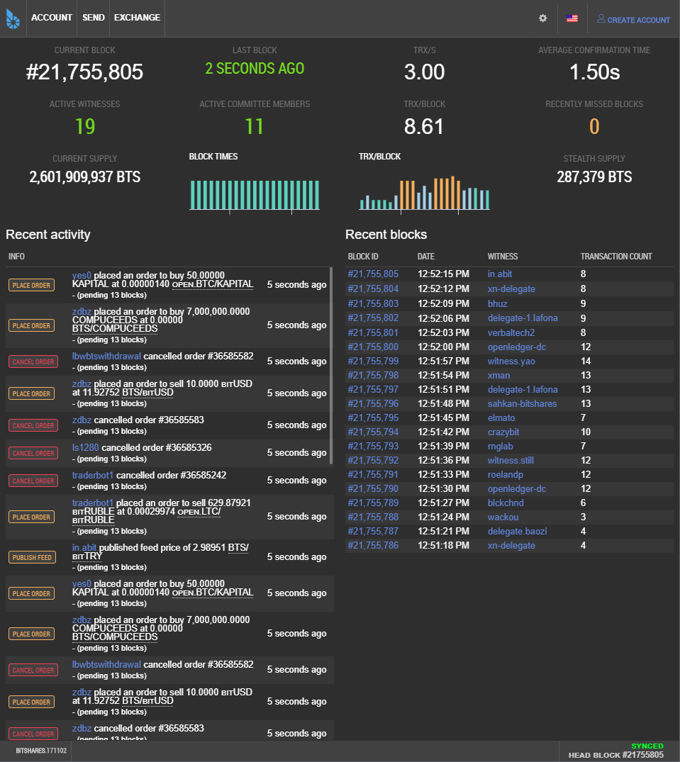
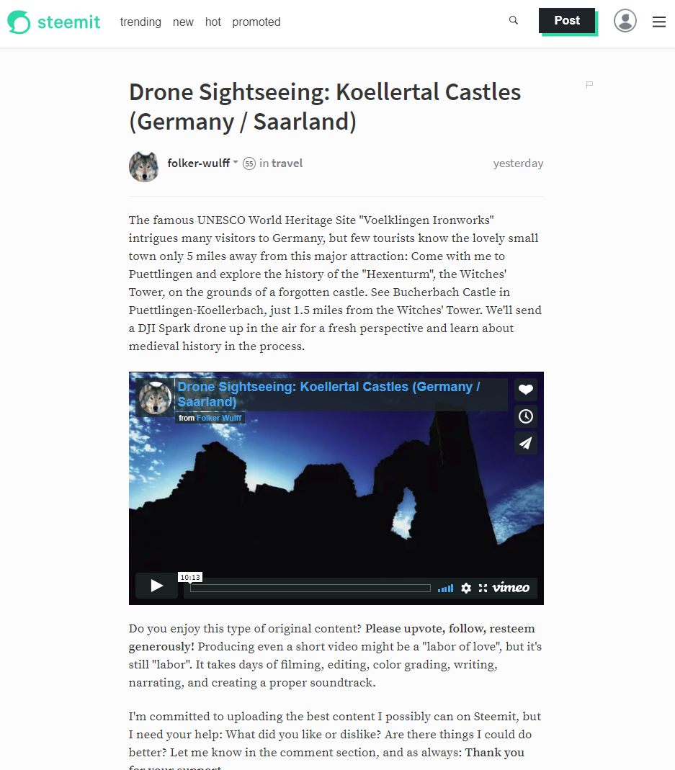
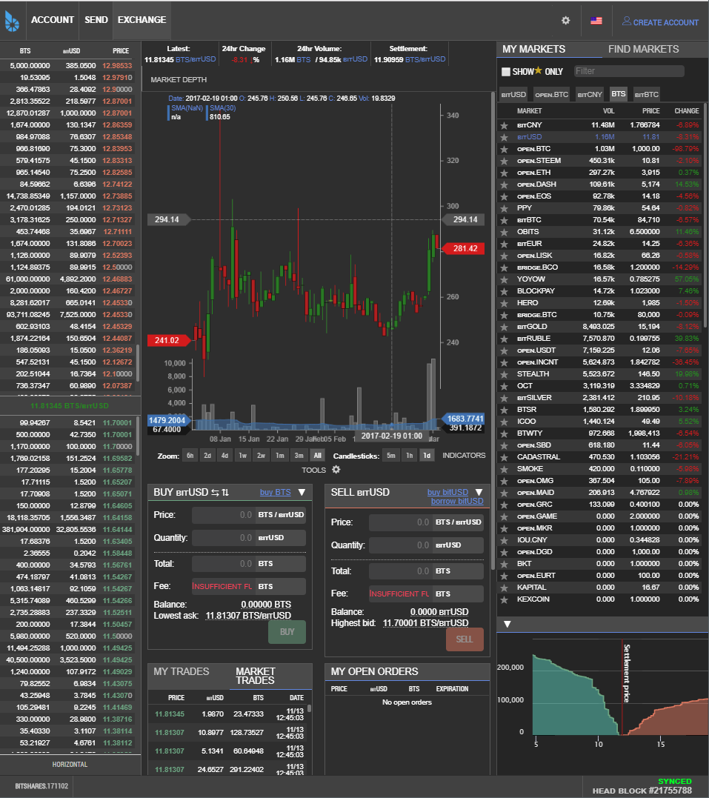
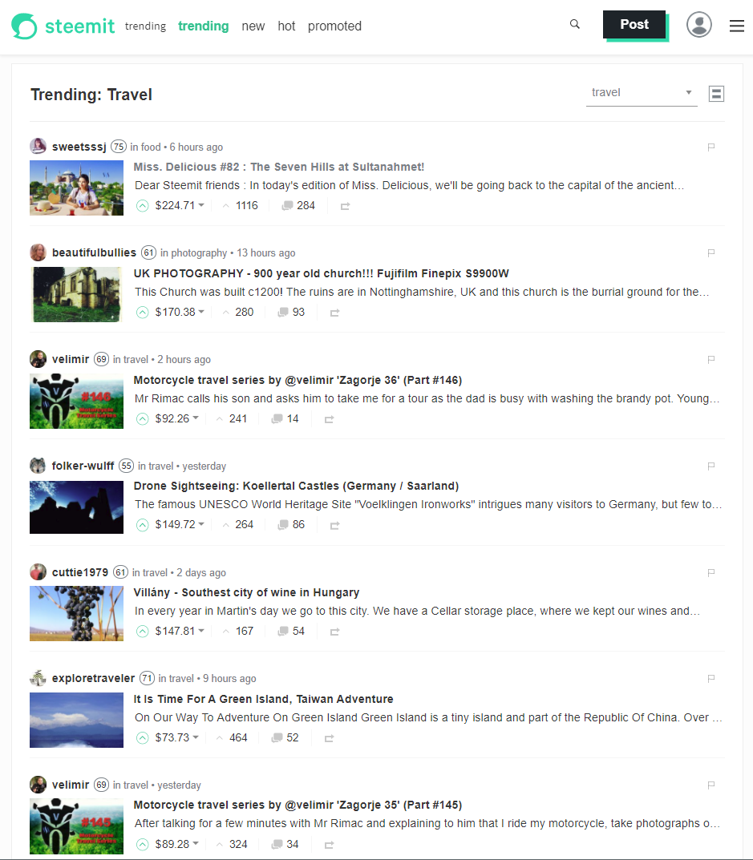
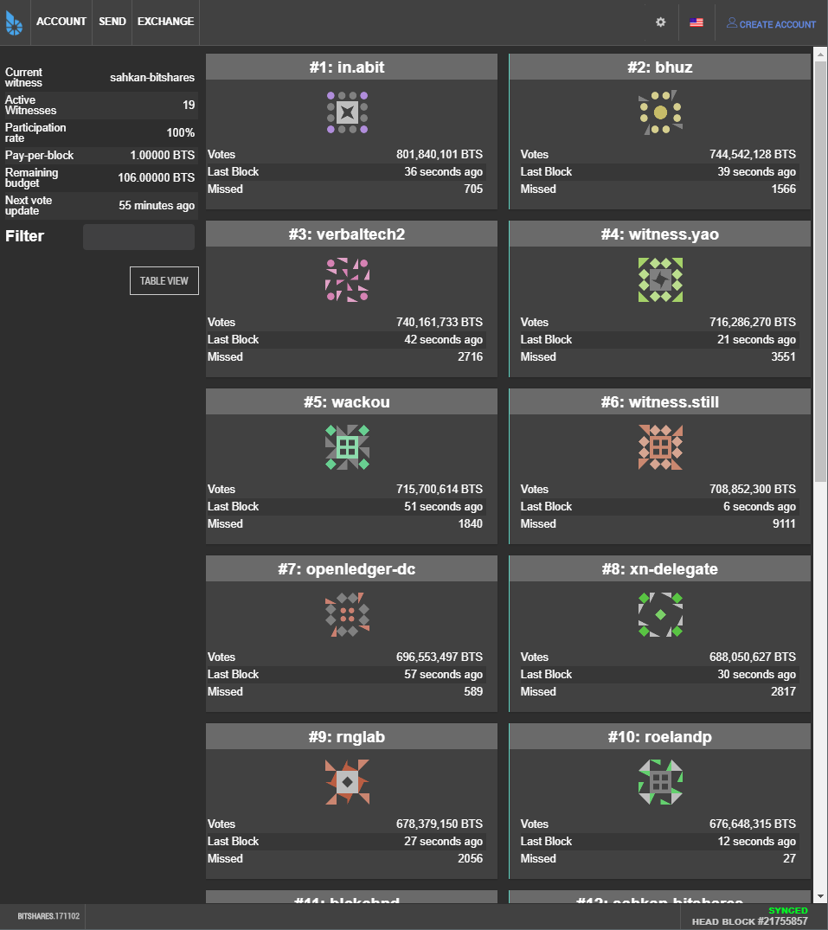
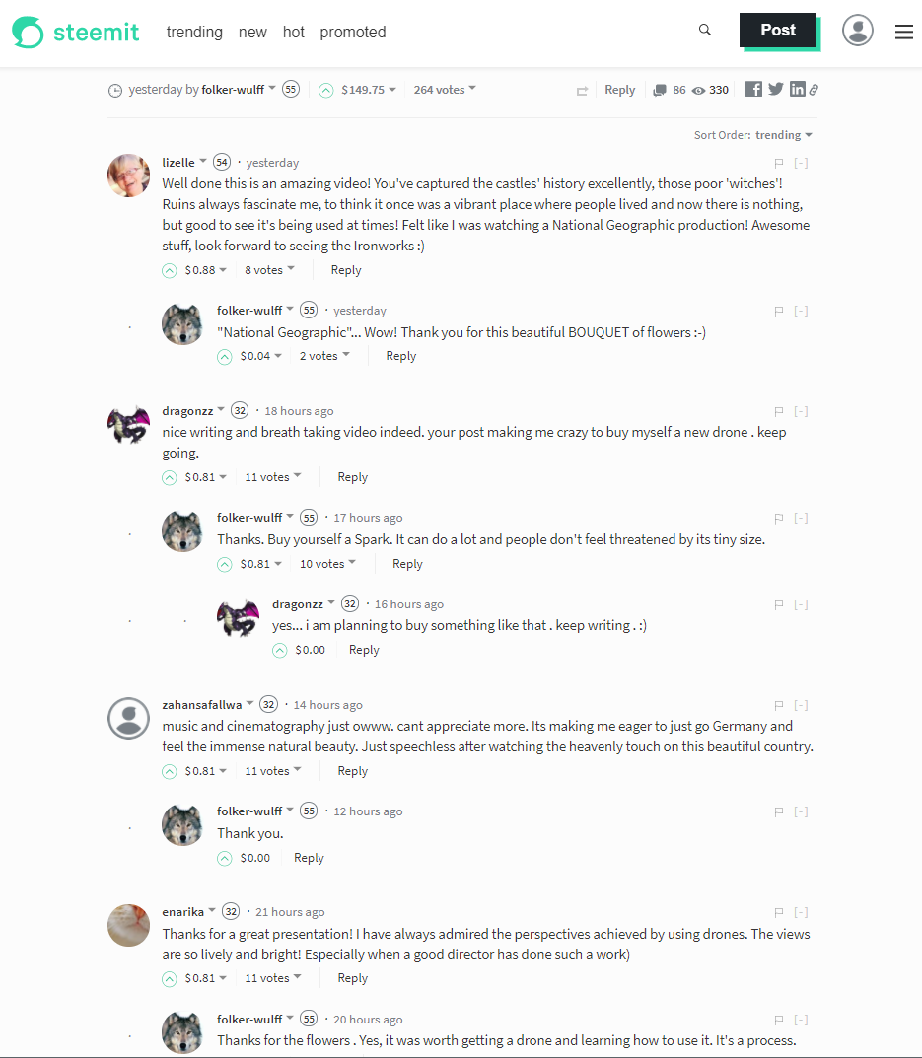
Source: bitshares.org & steemit.com

Slide 41
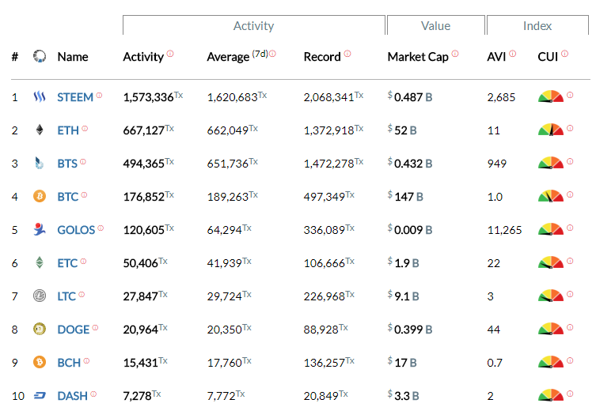
most active blockchains
Source: blocktivity.info

Slide 42
summary
Revolution or evolution?
Extremely business oriented
Pragmatic approach: people are integral part of the process

Slide 43
About Tokenika - OUR ROLE IN EOS ECOSYSTEM
Applications
Development Tools
DPOS Infrastructure
EOS
block.one

Slide 44
Thank you
EOS - official website
www.eos.io
Any questions?
Presented by
www.tokenika.io contact@tokenika.io
facebook.com/groups/Tokenika facebook.com/groups/EOSPolska

